Slide 1
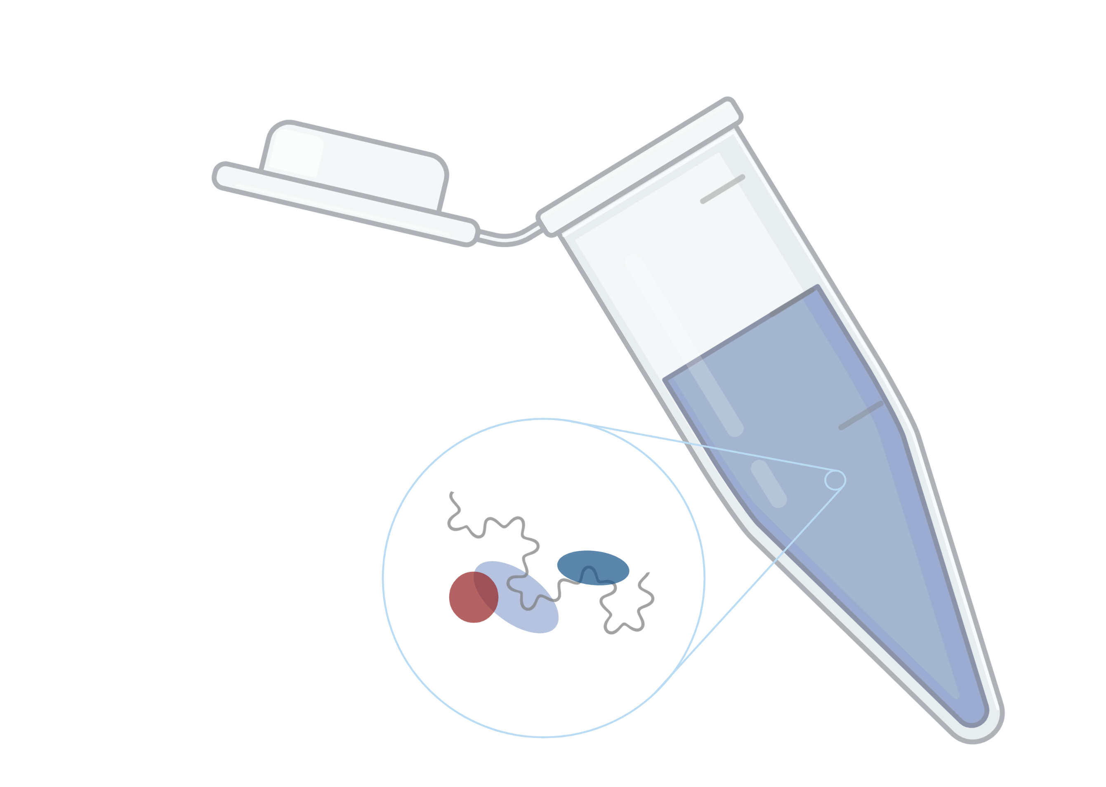
Proteome-wide Screen for RNA-dependent Proteins in HeLa cells
Project Proposal
Data Analysis Project 2022
Group 5: Katharina Lotter, Laura Herrfurth, Marie Lulu Salein, Kiren A. Nadeem
Supervisors: Dr. Maïwen Caudron-Herger, Niklas Engel
Molecular Biotechnology B.Sc. Ruprecht Karls University of Heidelberg
Created with BioRender.com

Slide 2
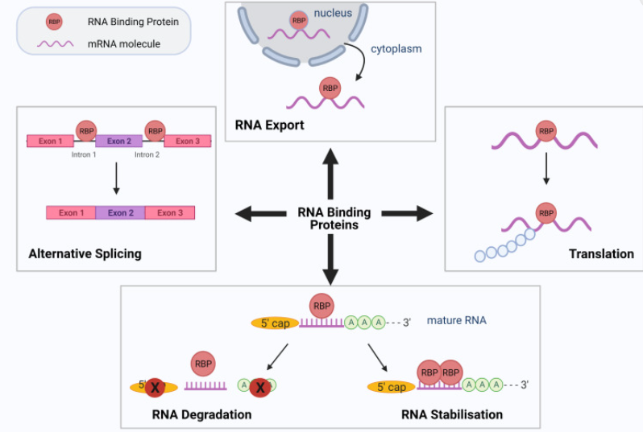
Why should we care? - The role of RBPs
Kelaini, S., C. Chan, V. A. Cornelius and A. Margariti (2021). "RNA-binding proteins hold key roles in function, dysfunction, and disease." Biology 10(5): 366

Slide 3
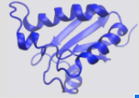
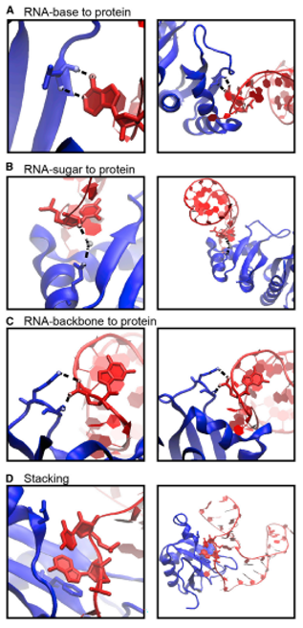
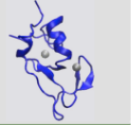
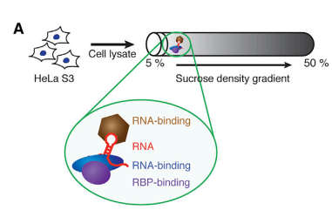
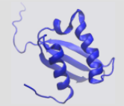
RBPs
Interaction
Dynamic
Cooperative & antagonistic
Heterogenous binding domains
Hydrogen bonds and stacking interactions
RNA recognition motif
Zinc finger binding domain
Corley, M., M. C. Burns and G. W. Yeo (2020). "How RNA-binding proteins interact with RNA: molecules and mechanisms." Molecular cell 78(1): 9-29
Caudron-Herger, M., S. F. Rusin, M. E. Adamo, J. Seiler, V. K. Schmid, E. Barreau, A. N. Kettenbach and S. Diederichs (2019). "R-DeeP: proteome-wide and quantitative identification of RNA-dependent proteins by density gradient ultracentrifugation." Molecular cell 75(1): 184-199. e110
K Homology
Corley, M., M. C. Burns and G. W. Yeo (2020). "How RNA-binding proteins interact with RNA: molecules and mechanisms." Molecular cell 78(1): 9-29
Notes:
RNA recognition motiv
90 amino acids
Definition
RNA binding
RNA dependent (interactome depends on RNA)
Amino acid preferences:
Regression analysis: can we predict if a protein is RNA dependent by looking at ist domains and its amino acid preferences
- How many other traits (e.g. the isoelectric point) do we have to include to make accurate predictions?

Slide 4
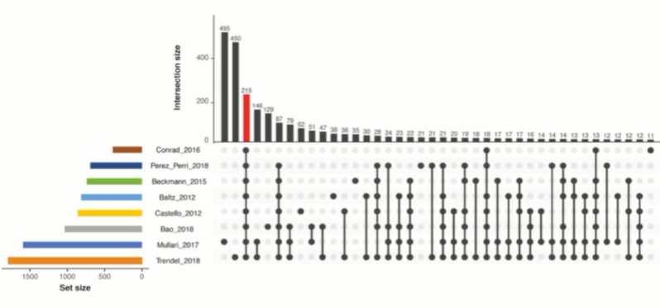
Why is that important? - Study gap on RBPs
Caudron-Herger, M., S. F. Rusin, M. E. Adamo, J. Seiler, V. K. Schmid, E. Barreau, A. N. Kettenbach and S. Diederichs (2019). "R-DeeP: proteome-wide and quantitative identification of RNA-dependent proteins by density gradient ultracentrifugation." Molecular cell 75(1): 184-199. e110
Notes:
Only 215 common proteins so far
High need for proteome wide studies dedicated to the identification of RBPs

Slide 5
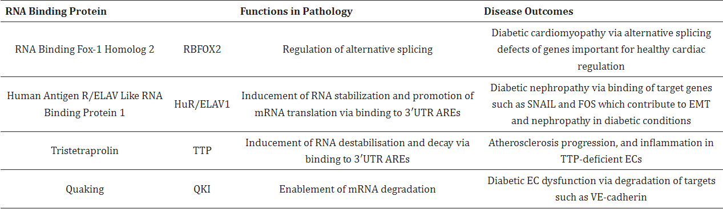
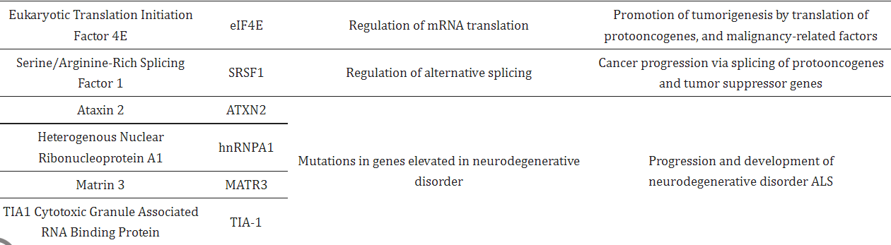
RBPs and diseases
Kelaini, S., C. Chan, V. A. Cornelius and A. Margariti (2021). "RNA-binding proteins hold key roles in function, dysfunction, and disease." Biology 10(5): 366
Notes:
Malfunction of RBPs results in severe diseases
Alternative splicing defects, RNA destabilization, stabilization of proto-onkogenes, alternative polyadenylation
Chronic inflammation and autoimmune diseases (involved in regulating the pro-inflammatory cytokines IL6 and TNF alpha)
Potential for cancer: targeting RBPs coupled with immunotherapy
Diabetic cardiomyopathy & nepropathy
Artherosclerosis progression

Slide 6
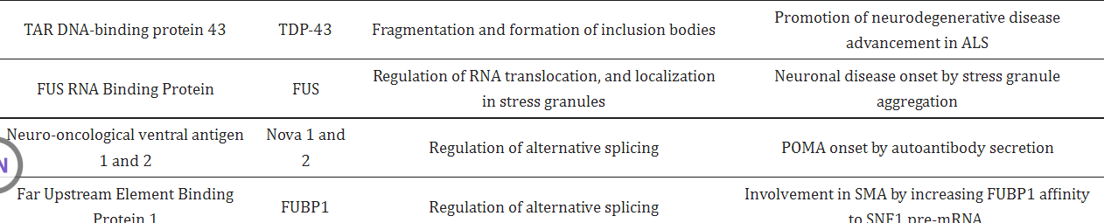
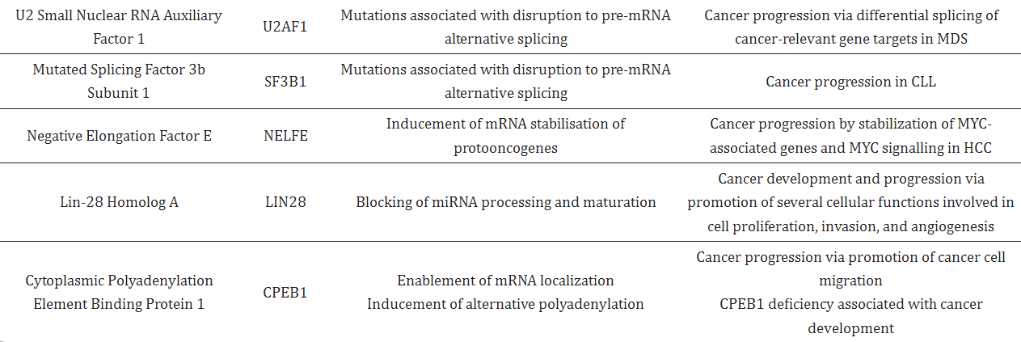
Kelaini, S., C. Chan, V. A. Cornelius and A. Margariti (2021). "RNA-binding proteins hold key roles in function, dysfunction, and disease." Biology 10(5): 366
Notes:
Not just severe consequences in cancer but also in neurodegenerative dieseases such as ALS
Fragmentation and formation of inclusion bodies
Important in embyronic development
Somatic tissue development: RBPs can have multiple target RNAs
Dendritogenesis in hippocampal neurons

Slide 7
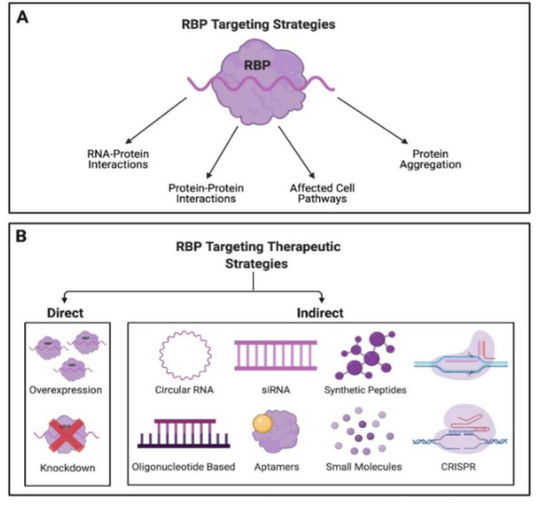
Why should everyone else care? - translational potential of RBP research
Kelaini, S., C. Chan, V. A. Cornelius and A. Margariti (2021). "RNA-binding proteins hold key roles in function, dysfunction, and disease." Biology 10(5): 366

Slide 8
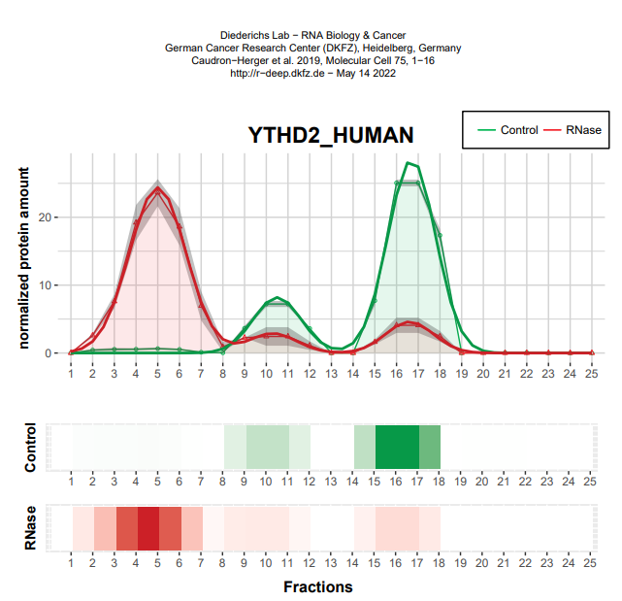
Example of RBP therapeutics: YTHDF2
RBP highly expressed in tumor cells
Depletion of YTHDF2 induces apoptosis in human triple-negative breast cancer cell lines
Impended xenograft tumor in vivo (mouse model) YTDF2 contributes to the EMT transition
Mice with YTDF2 knockout had less tumor cells
Einstein, J. M., M. Perelis, I. A. Chaim, J. K. Meena, J. K. Nussbacher, A. T. Tankka, B. A. Yee, H. Li, A. A. Madrigal and N. J. Neill (2021). "Inhibition of YTHDF2 triggers proteotoxic cell death in MYC-driven breast cancer." Molecular Cell 81(15): 3048-3064. e3049
Notes:
DOX: doxycycline inducible shRNAs, that target seveeral proteins mediating RNA stability
YTHDF2 hairpin was depleted in tumor cells which caused a growth disadvantage
Understanding RBPs will create discoveries with a high translational potential
Introduce us to new therapeutic targets
And in the end will advance research and development of therapies in areas with a high unmet medical need

Slide 9
What do we want to find out?
Which proteins are RBPs & RNA-dependent?
Regression analysis: Can we predict if a proteins is RNA-dependent by looking at its other traits?
Second dataset: How do RBPs change according to cellular context?
Which interactions during the cell cycle are transient?
Can we find something similar? Do Actin associated RNA-dependent proteins change during the cell cycle?

Slide 10
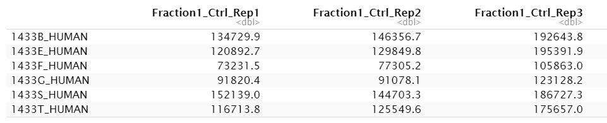
The dataset
3 replicates with control sample
+ 3 replicates with RNase sample
separated into 25 fractions
→ 3*3*25 = 150 columns
rows = proteins (7086)
Amount of protein in fraction 1 of replicate 1 with control sample
Notes:
Data frame with 7086 rows and 150 columns
Rows = proteins
Col = Fraction 1-25 for a replicate of control or rnase sample
Values in Dalton?

Slide 11
data cleanup & reduction & literature review II
data cleanup & reduction II
data exploration
buffer Week
data modelig
data modelling II
repetition & comparison of both datasets
wrap up & presenta-tion & report
finish presenta-tion & report
Milestones
Prepare Dataset for analysis
better understanding of biological question and project goal
1st week
2nd week
3rd week
4th week
5th week
6th week
7th week
8th week
9th week

Slide 12
Data cleanup & reduction
Literature review II
Data cleanup & reduction II
Data exploration
buffer Week
Data modellig
Data modelling II
Repeat with 2nd Dataset
&
Compare both Datasets
Wrapup data analysis
presentation & report
finish presentation & report
1st week
change class to numeric
analysis of zero’s
normalization protein quantity
deepen biological background and research of biological question
Milestones
prepare dataset for analysis
better understanding of biological question
2nd week
3rd week
4th week
5th week
6th week
7th week
8th week
9th week
Notes:
Details der Schritte hier rein

Slide 13
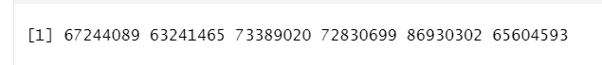
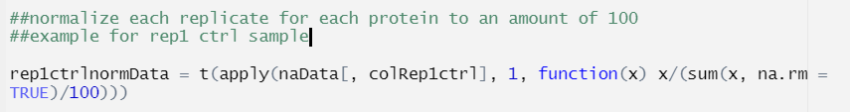

Statistical properties
every 6th measurement is part of one replicate
Different amounts of protein in replicates
many zeros

Slide 14
data cleanup & reduction & literature review II
data cleanup & reduction II
data exploration
buffer Week
data modeling
data modelling II
repetition & comparison of both datasets
w rap up & presenta-tion & report
finish presenta-tion & report
Milestones
Prepare Dataset for analysis
focus on essential information
1st week
2nd week
3rd week
4th week
5th week
6th week
7th week
8th week
9th week

Slide 15
Data cleanup & reduction
Literature review II
Data cleanup & reduction II
Data exploration
buffer Week
Data modellig
Data modelling II
Repeat with 2nd Dataset
&
Compare both Datasets
Wrapup data analysis
presentation & report
finish presentation & report
2nd week
identifying and removing batch effects
check reproducibility
dimension reduction
Milestones
prepare dataset for analysis
focus on essential information
1st week
3rd week
4th week
5th week
6th week
7th week
8th week
9th week
Notes:
Reproducability via variance checken
Mittelwerte berechnen und Varianz um Mittelwerte berechnen, Mittelwerte mit t-test verleichen und f-test für Varianz

Slide 16
data cleanup & reduction & literature review II
data cleanup & reduction II
data exploration
buffer Week
data modeling
data modelling II
repetition & comparison of both datasets
wrap up & presenta-tion & report
finish presenta-tion & report
Milestones
Identification of possible RNA-dependent proteins
figuring out whether RNA-binding proteins are often associated with actin
1st week
2nd week
3rd week
4th week
5th week
6th week
7th week
8th week
9th week

Slide 17
3rd week
fitting Gaussian curves
identifying maxima
plotting shifts between control and RNase samples
define criteria for shift identification
comparing to protein databases
Milestones
Identification of RBPs and properties
associated with actin?
Data cleanup & reduction
Literature review II
Data cleanup & reduction II
Data exploration
buffer Week
Data modeling
Data modelling II
Repeat with 2nd Dataset
&
Compare both Datasets
Wrap-up data analysis
presentation & report
finish presentation & report
1st week
2nd week
4th week
5th week
6th week
7th week
8th week
9th week

Slide 18
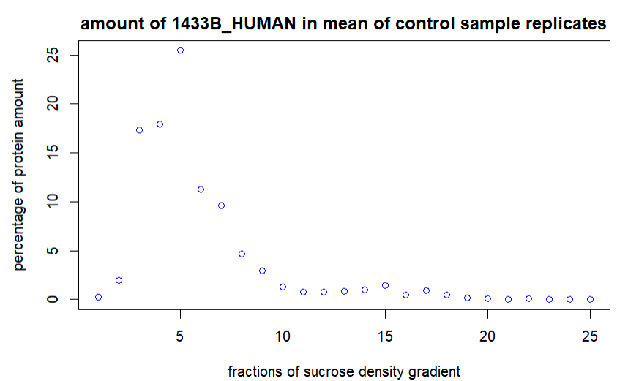
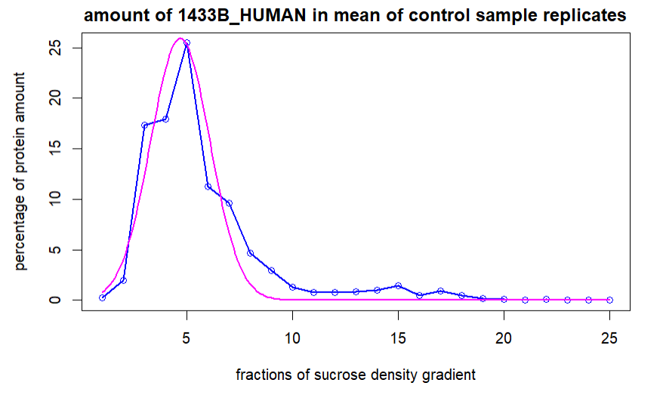
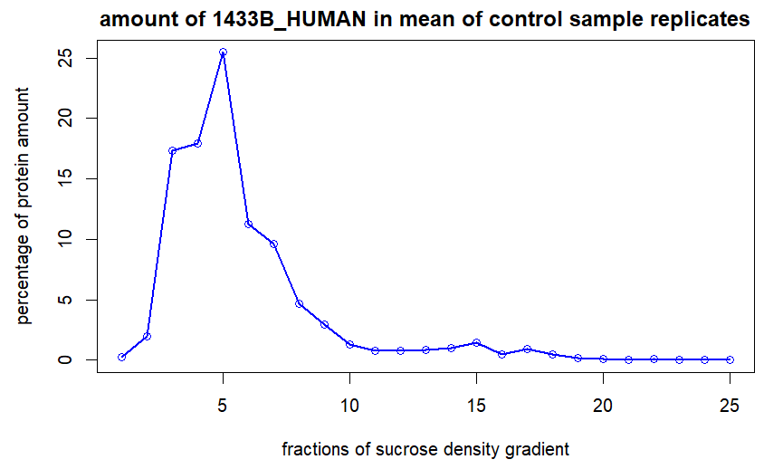
Gaussian approximation
Notes:
- How we imagine it to look like in the end

Slide 19
3rd week
fitting Gaussian curves
identifying maxima
plotting shifts between control and RNase samples
define criteria for shift identification
comparing to protein databases
Milestones
Identification of RBPs and properties
associated with actin?
Data cleanup & reduction
Literature review II
Data cleanup & reduction II
Data exploration
buffer Week
Data modeling
Data modelling II
Repeat with 2nd Dataset
&
Compare both Datasets
Wrap-up data analysis
presentation & report
finish presentation & report
1st week
2nd week
4th week
5th week
6th week
7th week
8th week
9th week

Slide 20
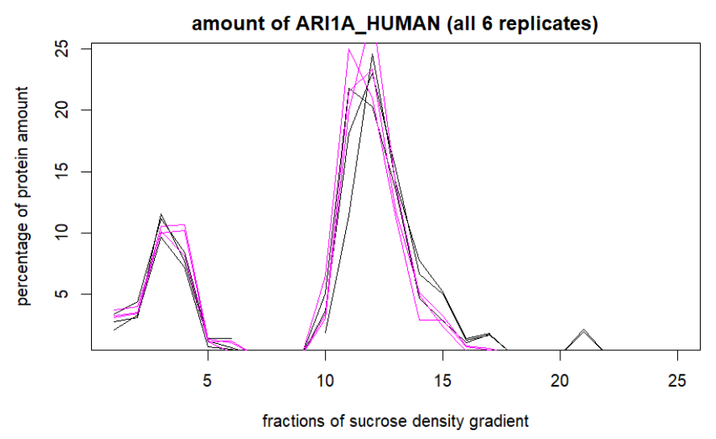
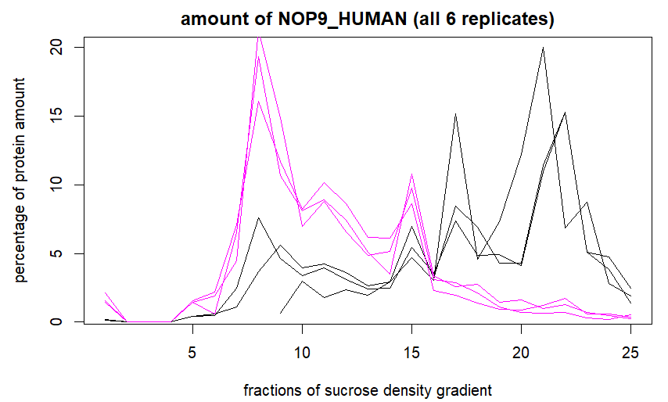
Shift between the fractions
Control = black
RNase = magenta

Slide 21
data cleanup & reduction & literature review II
data cleanup & reduction II
data exploration
buffer Week
data modeling
data modelling II
repetition & comparison of both datasets
wrap up & presenta-tion & report
finish presenta-tion & report
Milestones
check significance of shifts
overview possible properties of RBPs
1st week
2nd week
3rd week
4th week
5th week
6th week
7th week
8th week
9th week

Slide 22
4th week
statistical testing t-test
further comparison to protein databases
create boxplots for comparison
Milestones
check significance of shifts
overview possible properties of RBPs
Data cleanup & reduction
Literature review II
Data cleanup & reduction II
Data exploration
buffer Week
Data modeling
Data modelling II
Repeat with 2nd Dataset
&
Compare both Datasets
Wrap-up data analysis
presentation & report
finish presenta-tion & report
1st week
2nd week
4th week
5th week
6th week
7th week
8th week
9th week

Slide 23
data cleanup & reduction & literature review II
data cleanup & reduction II
data exploration
buffer Week
data modeling
data modelling II
repetition & comparison of both datasets
wrap up & presenta-tion & report
finish presenta-tion & report
Milestones
figuring out whether there are trends between RBPs and if so, what they are
figuring out a method to predict RBPs
1st week
2nd week
3rd week
4th week
5th week
6th week
7th week
8th week
9th week

Slide 24
5th week
k-means
regression analysis
if time: repeat data analysis steps with 2nd dataset
Milestones
trends between RBPs?
finding method to predict RBPs
Data cleanup & reduction
Literature review II
Data cleanup & reduction II
Data exploration
buffer Week
Data modeling
Data modelling II
Repeat with 2nd Dataset
&
Compare both Datasets
Wrap-up data analysis
presentation & report
finish presentation & report
1st week
2nd week
4th week
5th week
6th week
7th week
8th week
9th week
Notes:
wrapping up analysis
k-means clustering: elbow plot and/or silhoutte plot, for opt. k
-> notice trends between RBPs, and between RBPs and non RBPs.
-> Find connection between our RBPs and properties of RBPs
regression analysis between proteins (RBPs or not) and and properties connected to RBPs, eg. protein domains -> AS preferences
-> predict RBPs without looking for shifts

Slide 25
data cleanup & reduction & literature review II
data cleanup & reduction II
data exploration
buffer Week
data modeling
data modelling II
repetition & comparison of both datasets
wrap up & presenta-tion & report
finish presenta-tion & report
Milestones
figuring out whether there are differences between (amount of) RBPs between both cell cycle phases
figuring out whether there are changes in actin associated RBPs between cell cycle phases
1st week
2nd week
3rd week
4th week
5th week
6th week
7th week
8th week
9th week

Slide 26
6th week
repeat data analysis steps with 2nd dataset
compare findings 2nd dataset with protein databases
compare results of both datasets
Milestones
differences between RBPs between both cell cycle phases?
changes in actin associated RBPs between cell cycle phases?
Data cleanup & reduction
Literature review II
Data cleanup & reduction II
Data exploration
buffer Week
Data modeling
Data modelling II
Repeat with 2nd Dataset
&
Compare both Datasets
Wrap-up data analysis
presentation & report
finish presenta-tion & report
1st week
2nd week
4th week
5th week
6th week
7th week
8th week
9th week
Notes:
repeating beforementioned steps
compare to databases individually
compare to each other
-> changes between cell cycle phases
changes between actin associated RBPs

Slide 27
data cleanup & reduction & literature review II
data cleanup & reduction II
data exploration
buffer Week
data modeling
data modelling II
repetition & comparison of both datasets
wrap up & presenta-tion & report
finish presenta-tion & report
1st week
2nd week
3rd week
4th week
5th week
6th week
7th week
8th week
9th week

Slide 28
7th week
finish data analysis and dataset comparison
start writing project report
start preparation of final presentation
Data cleanup & reduction
Literature review II
Data cleanup & reduction II
Data exploration
buffer Week
Data modeling
Data modelling II
Repeat with 2nd Dataset
&
Compare both Datasets
Wrap-up data analysis
presentation & report
finish presentation & report
1st week
2nd week
4th week
5th week
6th week
7th week
8th week
9th week

Slide 29
data cleanup & reduction & literature review II
data cleanup & reduction II
data exploration
buffer Week
data modeling
data modelling II
repetition & comparison of both datasets
wrap up & presenta-tion & report
finish presenta-tion & report
1st week
2nd week
3rd week
4th week
5th week
6th week
7th week
8th week
9th week

Slide 30
Team organisation
at least one meeting per week
Where are we in the project?
Presenting what team members achieved
Open questions
Meeting after Tutorium
Assignment of tasks
Teams of two for more difficult tasks

Slide 31
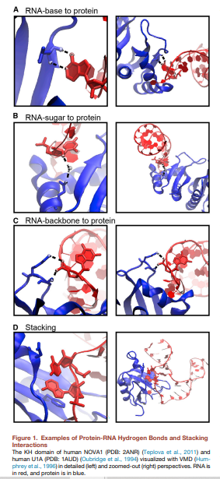
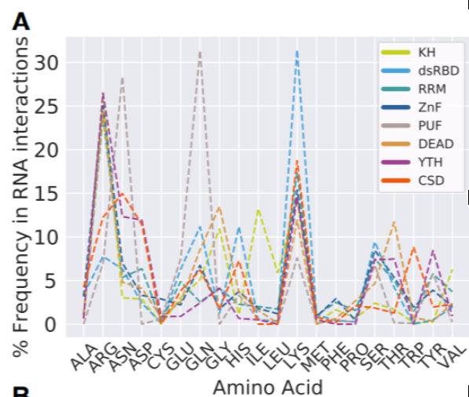
RBPs - Interaction with RNA
Hydrogen bonds and stacking interactions
Amino acid preferences of RBPs
Notes:
Amino acid preferences:
Regression analysis: can we predict if a protein is RNA dependent by looking at ist domains and its amino acid preferences
- How many other traits (e.g. the isoelectric point) do we have to include to make accurate predictions?

Slide 32
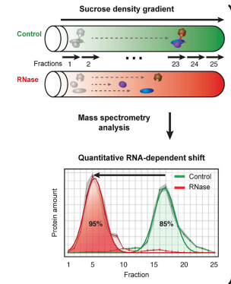
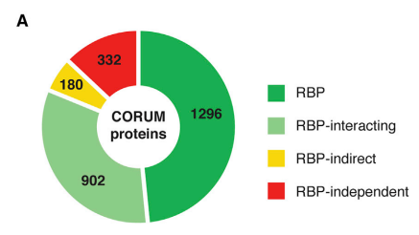
Sucrose Density Gradient Method - identification of new RBPs and RNA-dependent proteins
Caudron-Herger, M., S. F. Rusin, M. E. Adamo, J. Seiler, V. K. Schmid, E. Barreau, A. N. Kettenbach and S. Diederichs (2019). "R-DeeP: proteome-wide and quantitative identification of RNA-dependent proteins by density gradient ultracentrifugation." Molecular cell 75(1): 184-199. e110
If the protein is RNA dependent it will dissociate and migrate to a different fraction
Left shift: loss of interaction partners
Right shift: gain of interaction partners
Information on the quantitiy of the fraction that is associated with RNA
→ strategy to gain insight on RNA function by protein analysis
Notes:
Why is it important to know more about RBPs → severe diseases when malfunctioning

Slide 33
Why should we care? - The role of RBPs
RNA is essential for gene expression
RBPs regulate splicing & post translational modification
RNA is more than just a template!
Role of non coding RNA is still not completely understood
RNA is not alone
During every step of RNA metabolism RBPs are associated with RNA
Cooperative & antagonistic interactions
Dynamic associations
→fine-tuned regulation of their RNA targets

Slide 34
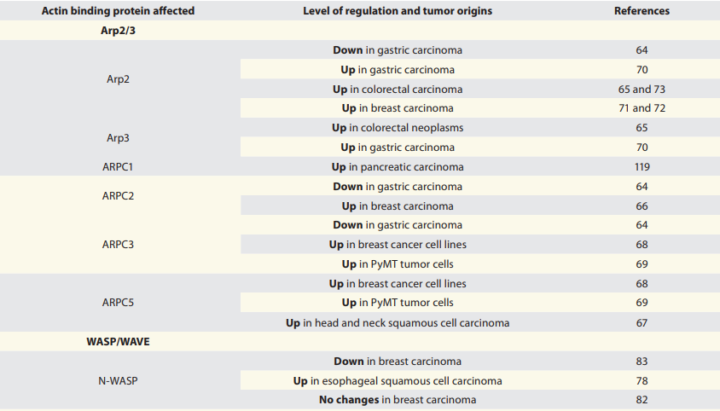
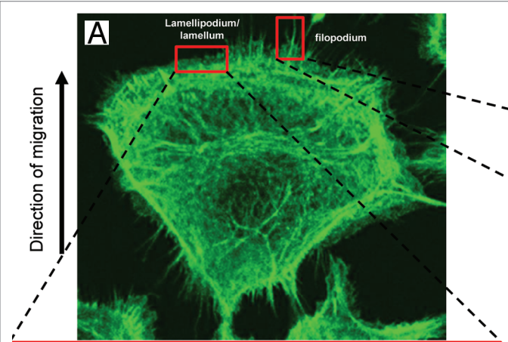
The role of Actin in cancer
Essential for cell motility
Cancer metastasis, cell division and proliferation
Invasivity of cancer cells & EMT
Potential of targeting cytoskeletal microfilaments in cancer therapy
Gross, S. R. (2013). "Actin binding proteins: their ups and downs in metastatic life." Cell adhesion & migration 7(2): 199-213

Slide 35
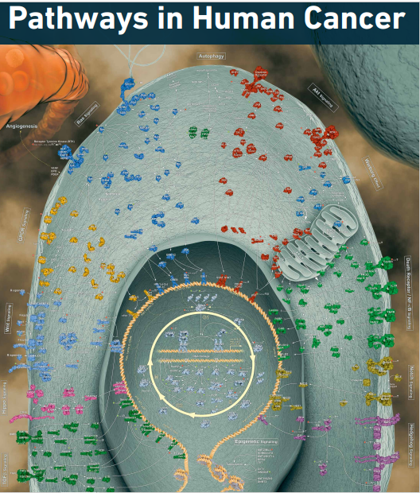
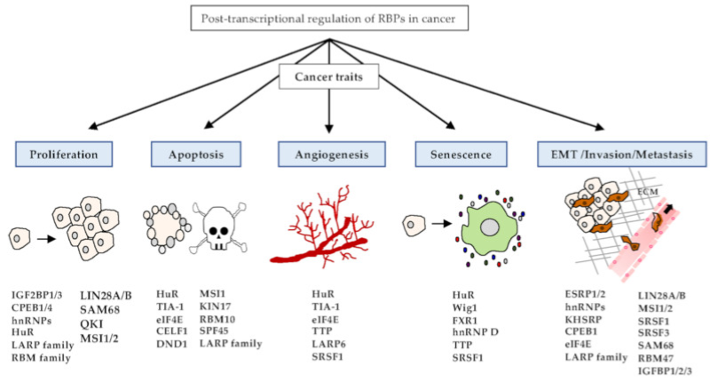
RBPs in cancer
Kang, D., Y. Lee and J.-S. Lee (2020). "RNA-binding proteins in cancer: functional and therapeutic perspectives." Cancers 12(9): 2699
Notes:
Knowledge on the understanding of cellular pathways (esp their dysfunction in cancer)
- RBPs are important for the promotion of cell proliferation, cell migration and angiogenesis
Function of non-coding RNAs
New therapeutic targets
So far research focus has mostly been on genomics
Focusing on transciptiomics might introduce medicine to a whole new area of cancer therapeutics

Slide 36
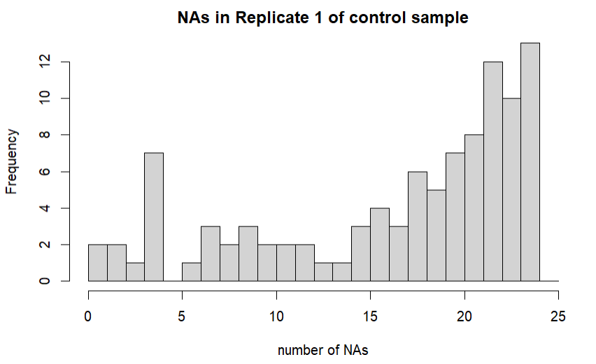
Statistical properties
Drop protein if it has more than 10 zeros in at least two replicates in control and/or RNase sample

Slide 37
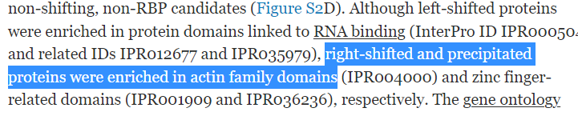
What do we want to find out?
Which proteins are RBPs & RNA-dependent?
Regression analysis: Can we predict if a proteins is RNA-dependent by looking at its other traits?
Second dataset: How do RBPs change according to cellular context?
Which interactions during the cell cycle are transient?
Can we find something similar? Do Actin associated RNA-dependent proteins change during the cell cycle?
Caudron-Herger, M., S. F. Rusin, M. E. Adamo, J. Seiler, V. K. Schmid, E. Barreau, A. N. Kettenbach and S. Diederichs (2019). "R-DeeP: proteome-wide and quantitative identification of RNA-dependent proteins by density gradient ultracentrifugation." Molecular cell 75(1): 184-199. e110

